Slide 1

TERMS AND CONDITIONS
These PowerPoint slides are a tool for lecturers, and as such:
YOU MAY add content to the slides, delete content from the slides, print out the slides, and save the slides onto your computer or server.
YOU MAY NOT resell, reproduce or redistribute the content in any form whatsoever, without prior written permission from the copyright holder.
© Troupant Publishers (Pty) Ltd, 2016
Selected images used under licence from Shutterstock.com

Slide 2
Engineering Systems
NQF Level 2

Slide 3

Engineering systems and their applications
Topic 1

Slide 4
Electrical systems
Module 1

Slide 5

VIDEO: Mike Gumbo

Slide 6
Electrical systems and their components
Unit 1.1

Slide 7
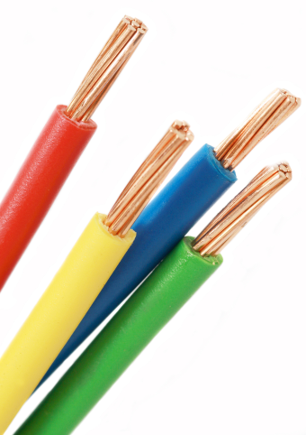
Basic electrical concepts
Conductors: materials that allow an electric current to pass through them.
Insulators:
materials that block the flow of electricity.

Slide 8
Direct current (DC)
Direct current (DC) is current that flows in one direction only in a circuit.
Example: current supplied in a torch by a battery

Slide 9
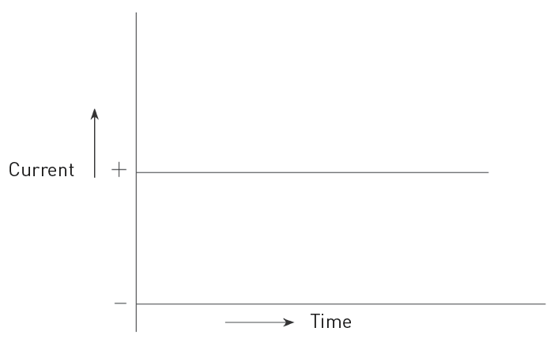
Direct current (DC)
Figure 1.3 Graphic representation of direct current (DC)

Slide 10
Alternating current (AC)
Alternating current (AC) is current where the direction and amplitude of the current flow changes at regular intervals.
Example: electricity supplied by a power station and supplied to homes.

Slide 11
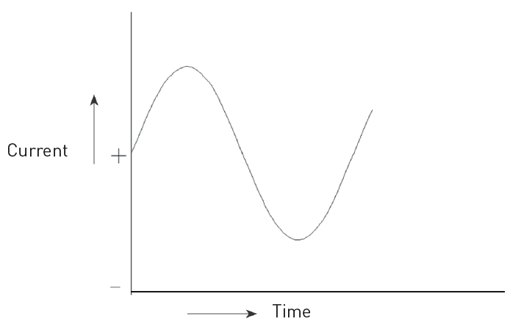
Alternating current (AC)
Figure 1.4 Graphic representation of alternating current (AC)

Slide 12
Basic electrical concepts
Electrical term | Symbol | SI unit
Electric current | I | ampere (A)
Potential difference | pd | volt (V)
Voltage | V | volt (V)
Electromotive force | emf | volt (V)
Resistance | R | ohms (Ω)

Slide 13
Ohm’s Law
The current flowing in a circuit is directly proportional to the applied voltage across the circuit and inversely proportional to the resistance of the circuit provided that the temperature remains constant.

Slide 14
Ohm’s Law
Can be rearranged to find voltage or resistance:

Slide 15
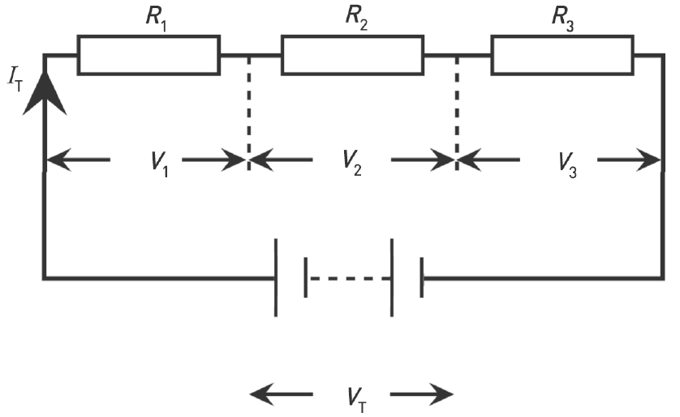
Series circuits
Figure 1.7 Resistors connected in series

Slide 16
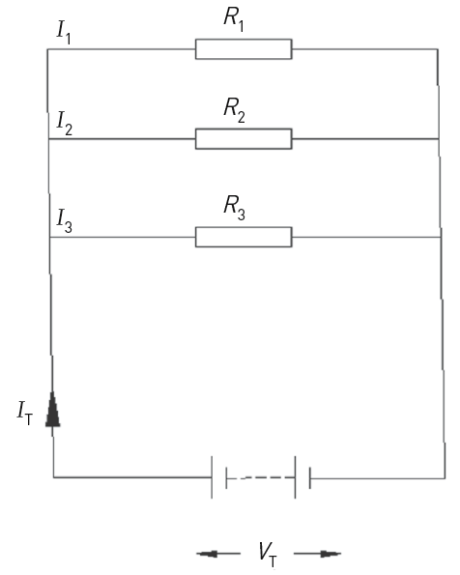
Parallel circuits
Figure 1.8 Resistors connected
in parallel

Slide 17

VIDEO: Series circuits

Slide 18
Measuring basic electrical quantities
Table 1.1 Measuring basic electrical quantities
Electrical quantity to be measured | Instrument needed | How to measure
Current | Ammeter | Connect in series
Voltage | Voltmeter | Connect in parallel across load
Resistance | Ohmmeter | Connect in parallel across component

Slide 19
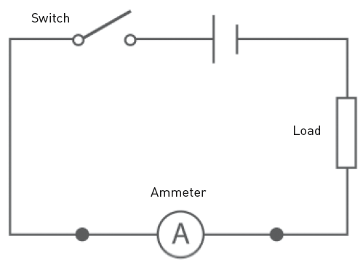
Measuring basic electrical quantities
Electrical quantity to be measured | Instrument needed | How to measure
Current | Ammeter | Connect in series
Figure 1.9 Connecting an ammeter in series in a circuit

Slide 20
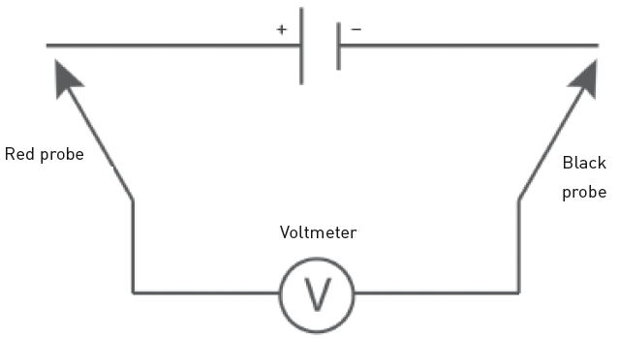
Electrical quantity to be measured | Instrument needed | How to measure
Voltage | Voltmeter | Connect in parallel across load
Figure 1.10 Measuring voltage in a DC circuit

Slide 21
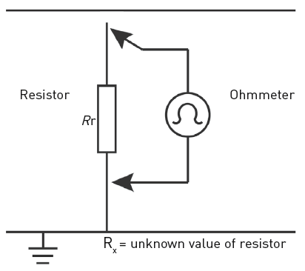
Electrical quantity to be measured | Instrument needed | How to measure
Resistance | Ohmmeter | Connect in parallel across component
Figure 1.11 Using an ohmmeter

Slide 22
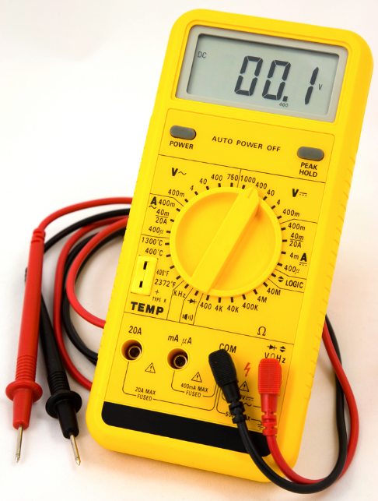
Multimeter
Figure 1.13 A digital multimeter

Slide 23
Factors influencing the resistance of a material
Length.
Cross-sectional area.
Resistivity.
Temperature.

Slide 24
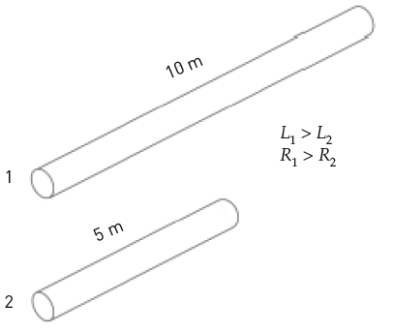
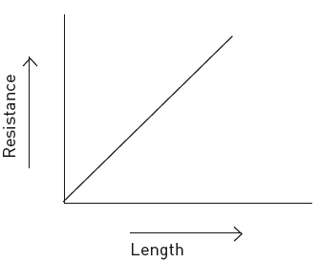
Factors influencing the resistance of a material
Length
Figure 1.15 Conductor 1 will have more resistance than conductor 2
Figure 1.16 The longer the wire is, the greater its resistance is

Slide 25
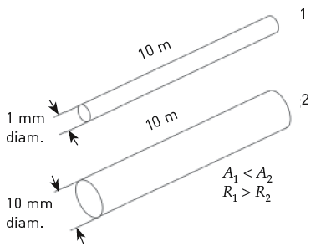
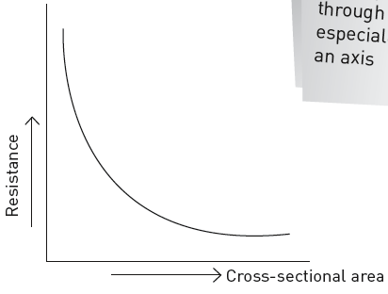
Factors influencing the resistance of a material
Cross-sectional area
Figure 1.17 The thicker the wire is, the less its resistance is
Figure 1.18 The inversely proportional relationship between resistance and cross-sectional area

Slide 26
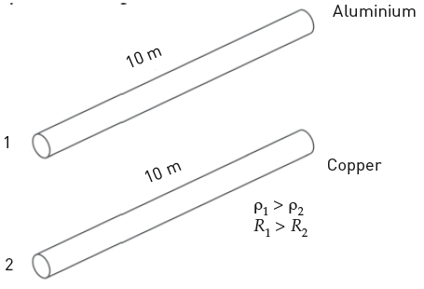
Factors influencing the resistance of a material
Resistivity
Figure 1.19 Conductor 1 will
have more resistance than
conductor 2

Slide 27
Factors influencing the resistance of a material
Temperature
The resistivity and resistance of a material change when temperature changes.
The resistance of most metals increases as their temperature increases.

Slide 28
Circuit diagrams
A circuit diagram uses symbols to represent all the circuit components and to show how the components are connected in a circuit.
Figure 1.20 A simple
circuit diagram

Slide 29
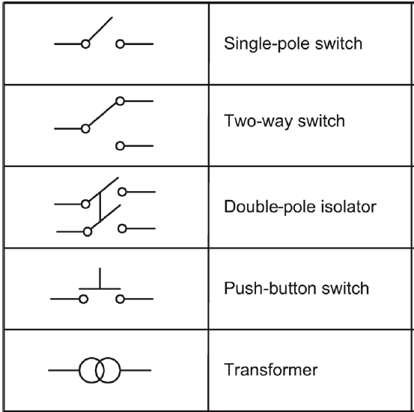
Table 1.2 Common electrical symbols

Slide 30
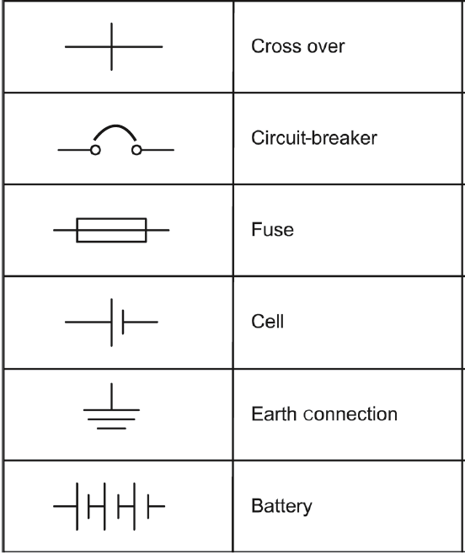
Table 1.2 Common electrical symbols (continued)

Slide 31
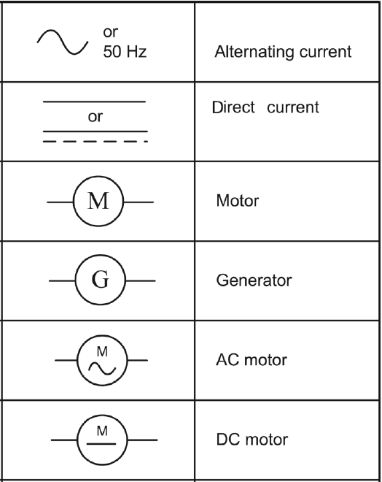
Table 1.2 Common electrical symbols (continued)

Slide 32
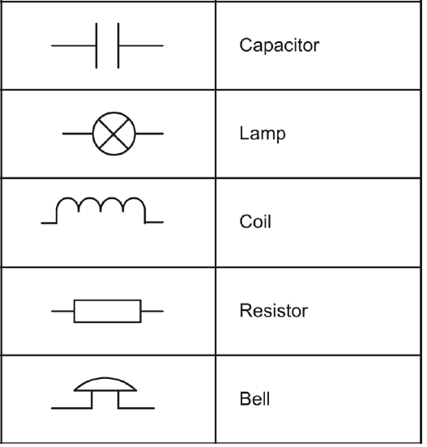
Table 1.2 Common electrical symbols (continued)

Slide 33
Guidelines for drawing circuit diagrams
Use the correct symbols.
Use a suitable symbol orientation.
Pay attention to the arrangement of symbols on the diagram.
Pay attention to the routing of interconnections.
Make sure your drawing is neat and tidy.

Slide 34
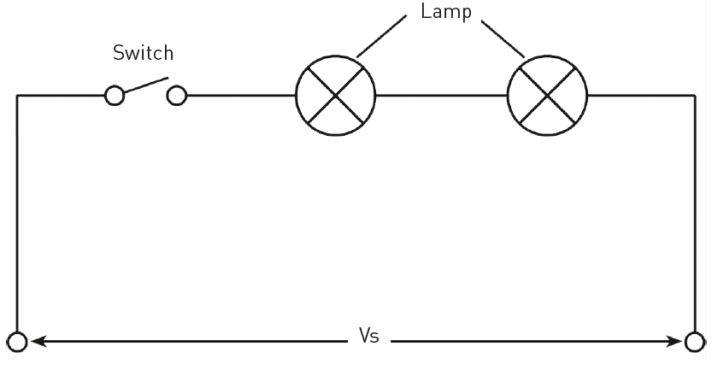
Lamps in series
Figure 1.22 Two lamps connected in series

Slide 35
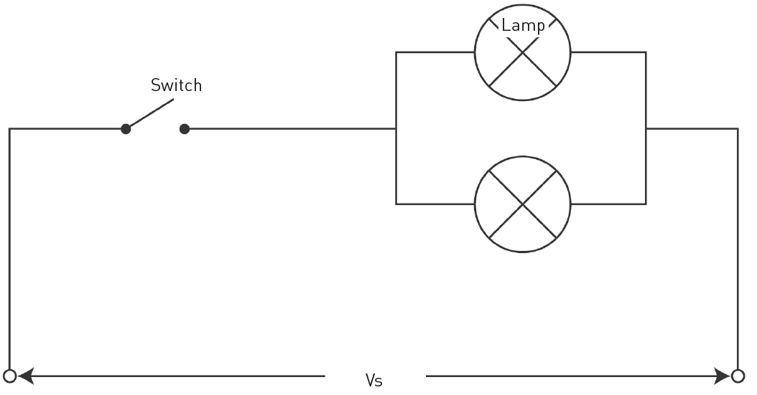
Lamps in parallel
Figure 1.23 Two lamps in parallel

Slide 36
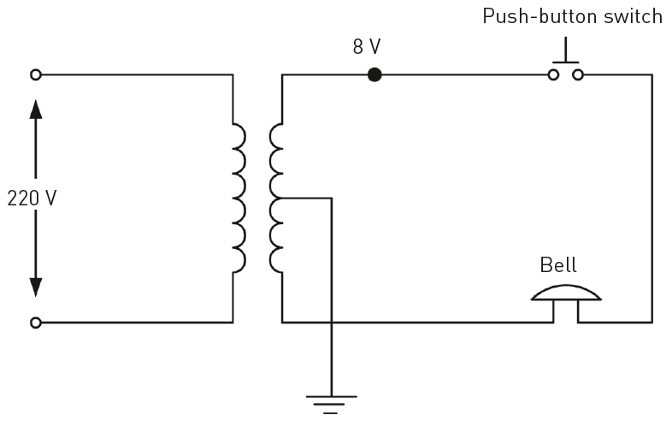
A bell circuit
Figure 1.25 A bell circuit

Slide 37
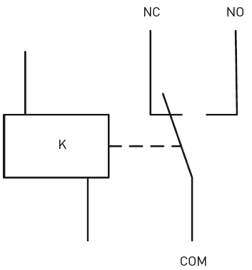
A relay circuit
Figure 1.27 Symbols for a relay

Slide 38
Control devices for circuits – switches
Switches are used to control an electrical device or system and open and close a circuit.
When the switch is open, the circuit is open and no current can flow.
When the switch is closed, current will flow.

Slide 39

Switches
Single-pole single-throw (SPST) switch
Figure 1.28 A single-pole single-throw (SPST) switch

Slide 40
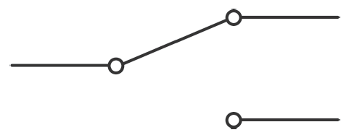
Switches
Single-pole double-throw (SPDT) switch
Figure 1.29 A single-pole double-throw (SPDT) switch

Slide 41
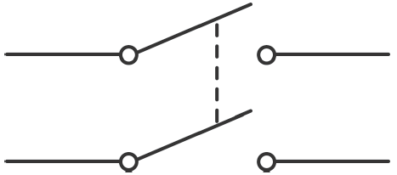
Switches
Double-pole single-throw (DPST) switch
Figure 1.30 A double-pole single-throw (DPST) switch

Slide 42
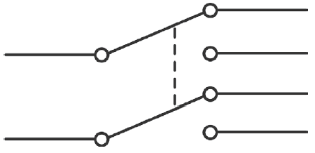
Switches
Double-pole double-throw (DPDT) switch
Figure 1.31 A double-pole double-throw (DPDT) switch

Slide 43
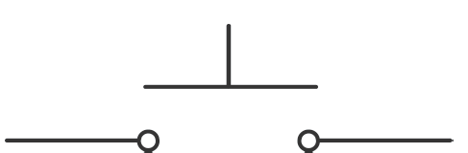
Push switches or buttons
Two basic types of push or button switches:
Push-to-make switches.
Push-to-break switches.
Figure 1.32 A push-to-make switch

Slide 44

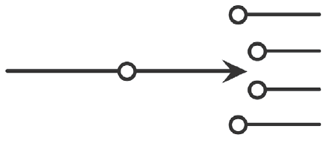
Push switches or buttons
Push-to-break switches
Multiposition switch
Figure 1.33 A push-to-break switch
Figure 1.34 A multiposition switch

Slide 45
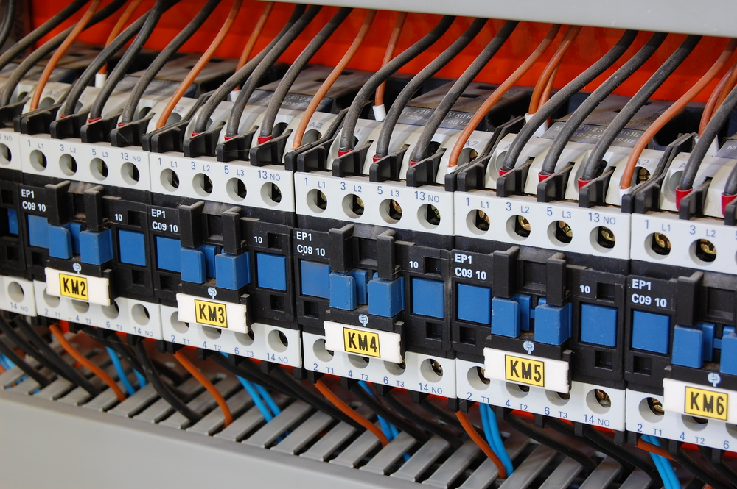
Contactors
Figure 1.35 A contactor

Slide 46
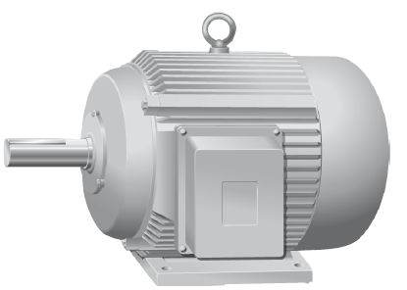
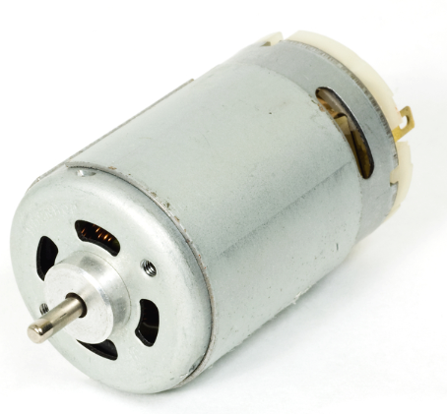
Motors
DC motor
AC motor
Figure 1.36 An AC motor
Figure 1.37 A DC motor

Slide 47
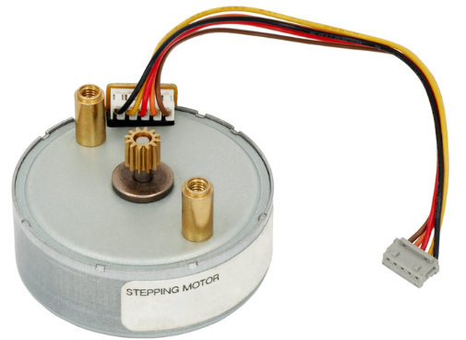
Motors
Stepper motor
Figure 1.38 A stepper motor

Slide 48
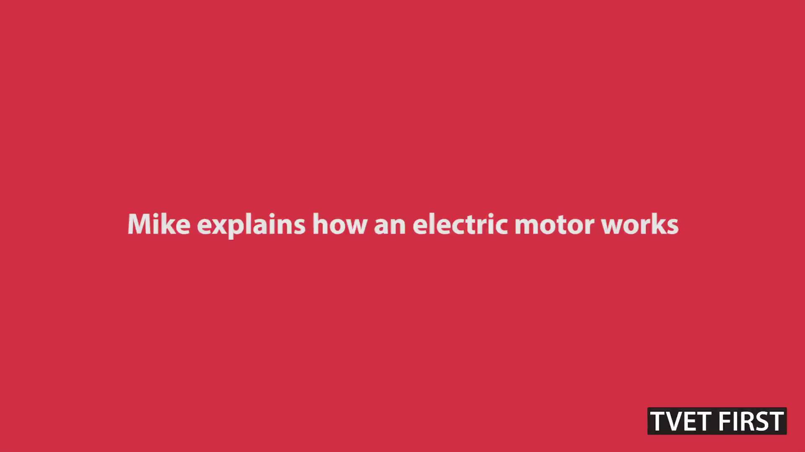
VIDEO: Motor

Slide 49
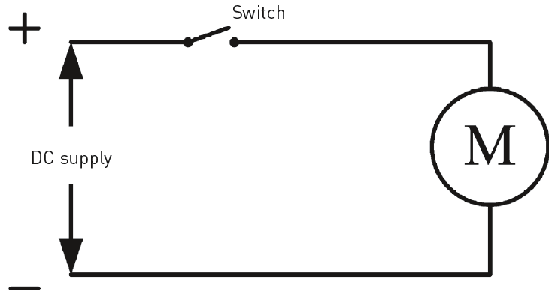
Control devices for motors
Simple DC control
Figure 1.39 Simple DC control

Slide 50
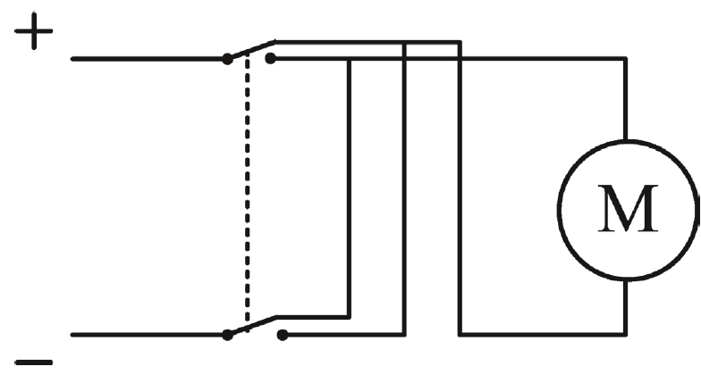
Simple DC control
Reversing the direction of a DC motor.
Figure 1.40 Reversing the direction of a DC motor

Slide 51
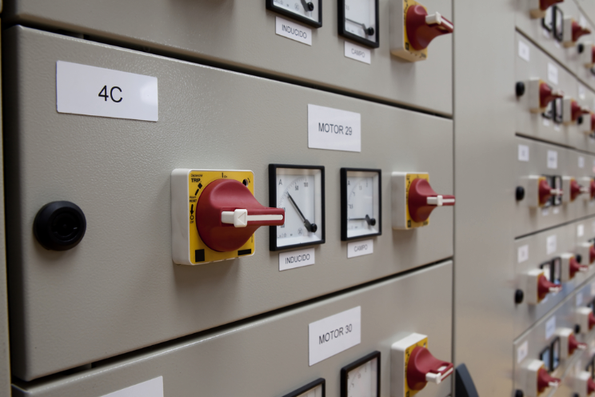
Rotary switches
Figure 1.41 Rotary switches used to control motors

Slide 52
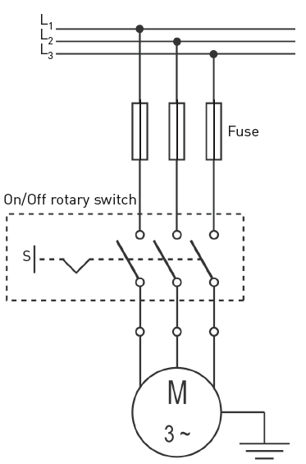
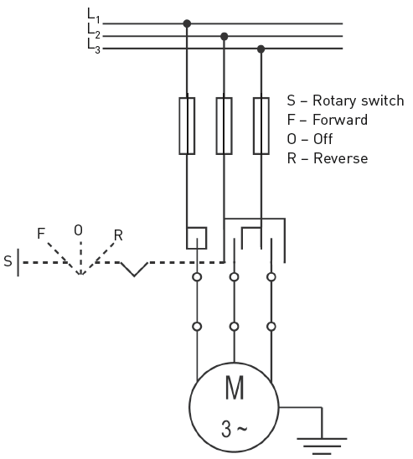
Manual forward or reverse switches
Figure 1.42 Direct starting on motor
Figure 1.43 Forward or reverse of a motor

Slide 53
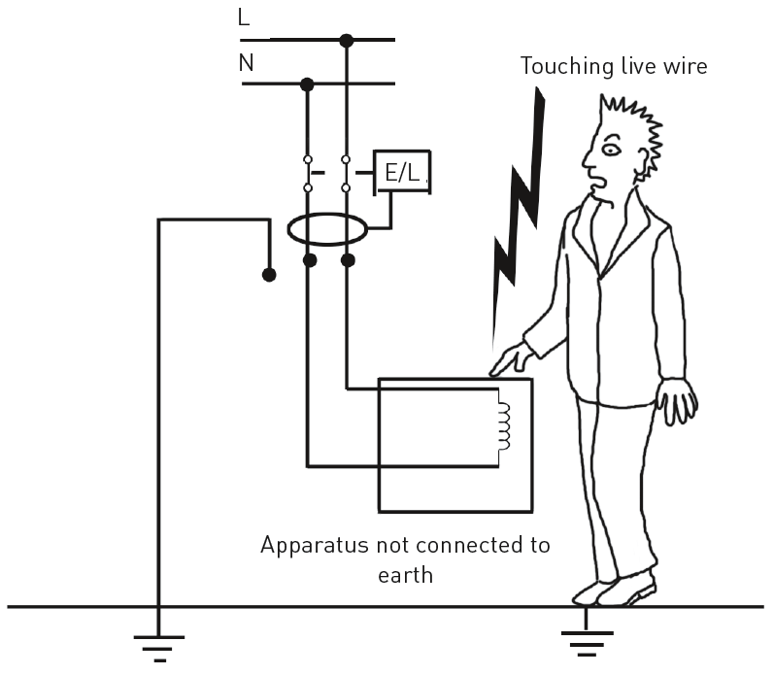
Earthing
Types of electric shocks:
  Direct contact.
  Indirect contact.
Figure 1.45 Direct contact with unearthed electrical equipment

Slide 54
Circuit protection devices
Purpose of circuit protection devices:
  Prevent damage to the circuit.
  Prevent fires.
  Protect against personal injury.
Two basic forms of electrical faults:
  Short circuits.
  Overload.

Slide 55
Types of protection devices
Fuses.
Circuit-breakers.
Isolators.
Earth leakage units.

Slide 56
Types of protection devices
Fuses.
Designed to melt in case of excessive
current.
Figure 1.47 Slow-blow fuses

Slide 57
Types of protection devices
Circuit-breakers.
Devices with preset
current limits that operate
automatically to protect
a circuit.
Figure 1.50 A circuit-breaker

Slide 58
Types of protection devices
Isolators.
Figure 1.51 An isolator

Slide 59
Types of protection devices
Earth leakage units.
Figure 1.52 An earth leakage unit

Slide 60
Plugs
Protective earthing conductor: ends at top pin or largest pin – yellow/green.
Live conductor: ends at the bottom right-hand pin - brown.
Neutral conductor: Ends at the bottom left-hand pin – blue.

Slide 61
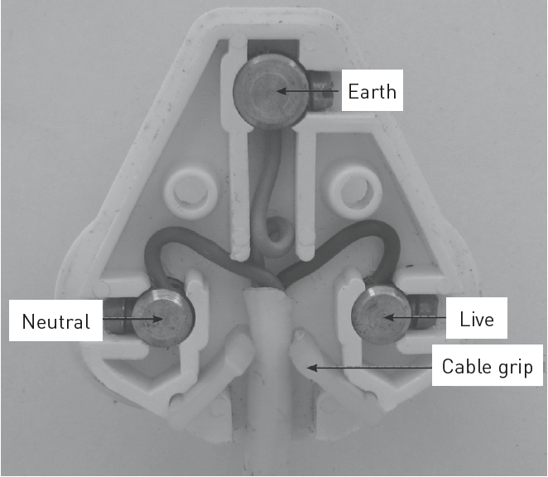
Plugs
Figure 1.53 Terminal arrangement for plugs

Slide 62
Consequences of wiring a plug incorrectly
It can cause a fire.
There is risk of injury from an electric shock.
Equipment may be damaged.
It can void the warranty of the equipment.

Slide 63
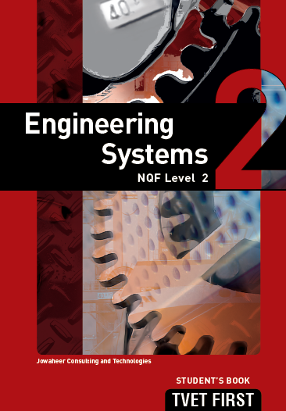
Summative assessment
Test your knowledge of this section by completing the
Summative assessment
(page 23 of your Student’s Book)

